Slide 1
Architecture Design
Instructor: Mehroze Khan

Slide 2
Mapping Data Flow into Architecture
A mapping technique, called structured design provides a convenient transition from a data flow diagram to software architecture
Types of Information Flow:
Transform Flow
Flow of data occurs in a sequential manner and follows one, or only a few, "straight line" paths.
Incoming Flow: Conversion of data from external to internal form
Transform Center: Incoming data passed through Transform center
Outgoing Flow: Conversion from internal to external form
Transaction Flow
Single data item triggers data flows along one of many paths
Incoming Flow: Converts external world information into a transaction
Transform Center: Hub of information flow from which many action paths come out
Action Paths: Transaction is evaluated and based on its value, flow along one of many action paths is initiated

Slide 3
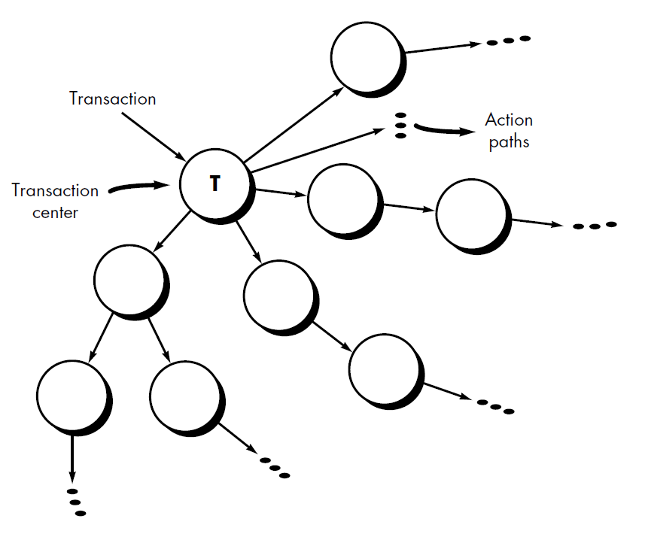
Mapping Data Flow into Architecture (Transaction Flow)

Slide 4
Mapping Data Flow into Architecture (Transform Mapping)
Steps to map Data Flow Diagrams into a Software Architecture:
Review the fundamental system model
Review and refine data flow diagrams for the software
Determine whether DFD has transaction flow or transform flow characteristics
Isolate transform center by specifying incoming and outgoing flow boundaries
Perform “first-level factoring”
Perform “second-level factoring”
Refine the first-iteration architecture using design heuristics for improved software quality

Slide 5
Example
Our research indicates that the market for home security systems is growing at a rate of 40 percent per year.
We would like to enter this market by building a microprocessor-based home security system that would protect against and/or recognize a variety of undesirable "situations" such as illegal entry, fire, flooding, and others.
The product, tentatively called SafeHome, will use appropriate sensors to detect each situation, can be programmed by the homeowner, and will automatically telephone a monitoring agency when a situation is detected.

Slide 6
Example
Safe Home is a home management product that allows homeowners to control their homes using their PC and Cell phone remotely. Home security, home surveillance, appliance and device control are a few functionalities that are provided by the Safe Home product. Initial design tells that both the Internet interface and the other Graphical User Interface (GUI) are both part of external communication management module. Security related hardware management includes control panel processing (i.e., keypad and display function), detector management (i.e., scheduler and sensors etc.), alarm processing (i.e., phone communication, alarm management etc.). Other modules include Surveillance module and Home management module. Surveillance module monitors the inappropriate activities around and inside the home. Home management module allows the users to control devices (e.g., switch off A/C, tube light etc.).

Slide 7
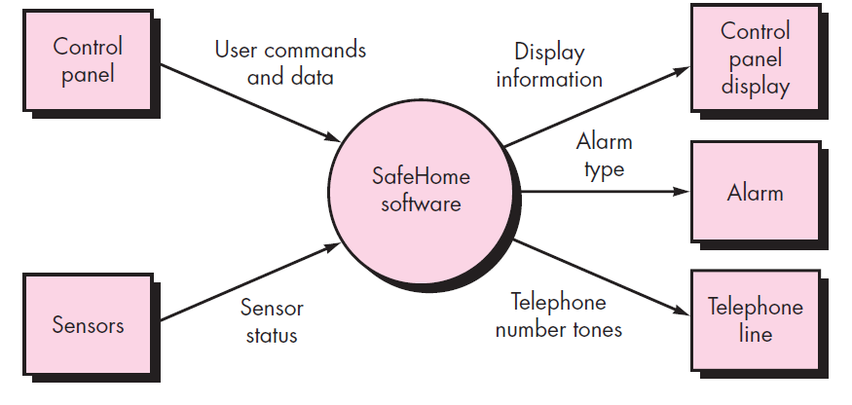
Step 1: Review the fundamental system model (Level-0 DFD)

Slide 8
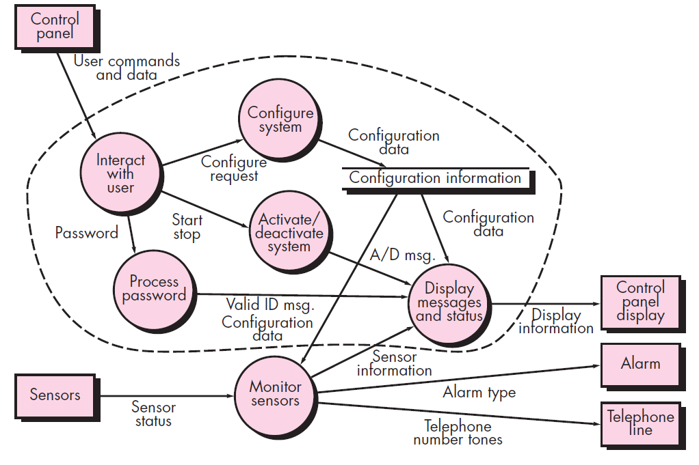
Level-1 DFD

Slide 9
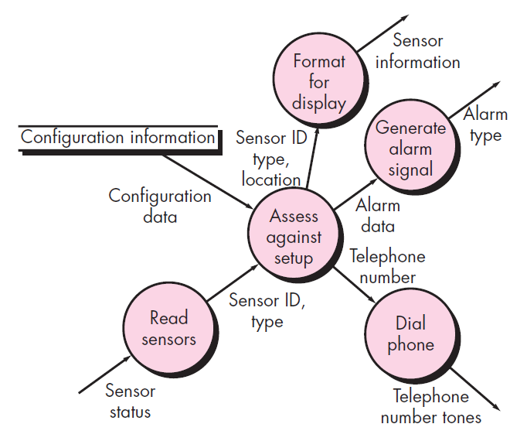
Step 2: Review and refine data flow diagrams for the software (Level-2 DFD for Monitor Sensors)

Slide 10
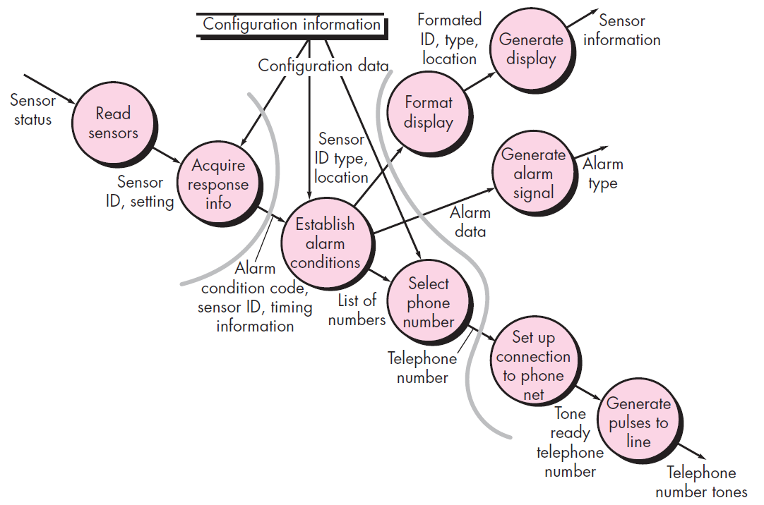
Step 2: Review and refine data flow diagrams for the software(Level-3 DFD)
Notes:
At level 3, each transform in the data flow diagram exhibits relatively high cohesion. That is, the process implied by a transform performs a single, distinct function that can be implemented as a module in the SafeHome software. Therefore, the DFD contains sufficient detail for a "first cut" at the design of architecture for the monitor sensors subsystem, and we proceed without further refinement.

Slide 11
Step 3: Determine whether DFD has transaction flow or transform flow characteristics
Evaluating the DFD, we see data entering the software along one incoming path and exiting along three outgoing paths. Therefore, an overall transform characteristic will be assumed for information flow.

Slide 12
Step 4: Isolate transform center by specifying incoming and outgoing flow boundaries

Slide 13
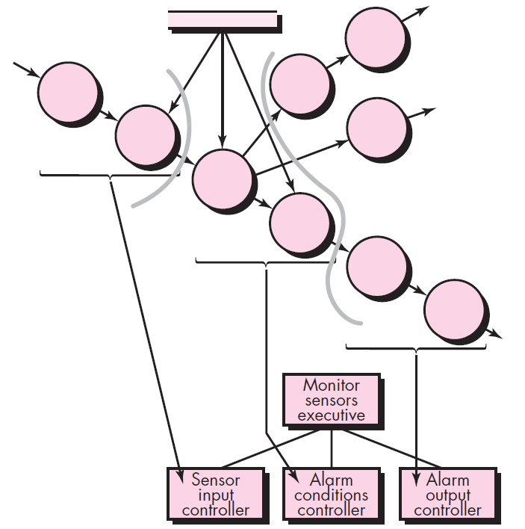
Step 5: Perform “first-level factoring”
Notes:
Factoring leads to a program structure in which top-level components perform decision making and low-level components perform most input, computation, and output work. Middle-level components perform some control and do moderate amounts of work.
An incoming information processing controller, called sensor input controller, coordinates receipt of all incoming data.
A transform flow controller, called alarm conditions controller, supervises all operations on data in internalized form (e.g., a module that invokes various data transformation procedures).
An outgoing information processing controller, called alarm output controller, coordinates production of output information.
A main controller (called monitor sensors executive) resides at the top of the program structure and coordinates the following subordinate control functions:
• An incoming information processing controller, called sensor input controller, coordinates receipt of all incoming data.
• A transform flow controller, called alarm conditions controller, supervises all operations on data in internalized form (e.g., a module that invokes various data transformation procedures).
• An outgoing information processing controller, called alarm output controller, coordinates production of output information.

Slide 14
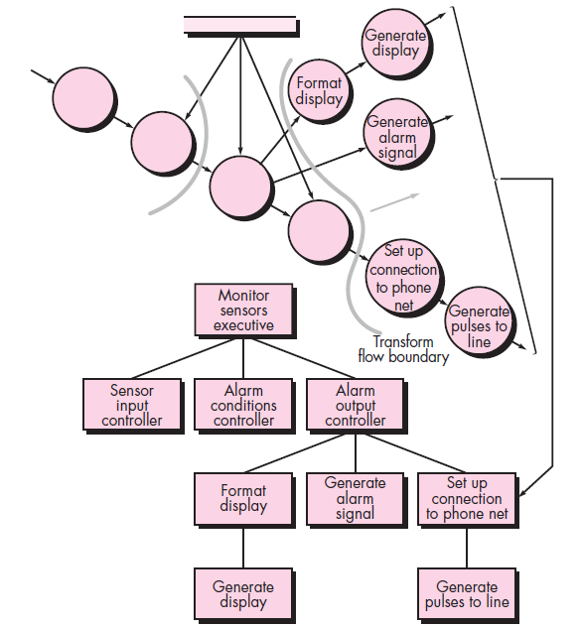
Step 6: Perform “second-level factoring”
Notes:
Second-level factoring is accomplished by mapping individual transforms (bubbles) of a DFD into appropriate modules within the architecture.
A one-to-one mapping between DFD transforms and software modules, different mappings frequently occur. Two or even three bubbles can be combined and represented as one component, or a single bubble may be expanded to two or more components.

Slide 15
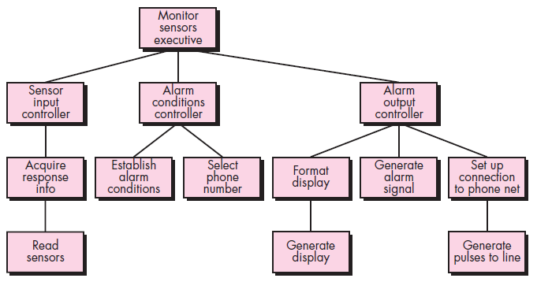
Step 6: Perform “second-level factoring”

Slide 16
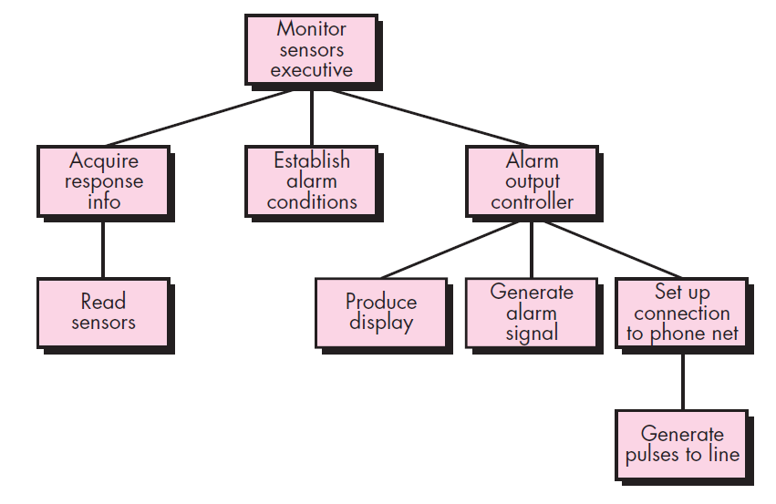
Step 7: Refine the first-iteration architecture using design heuristics for improved software quality
Notes:
A first-iteration architecture can always be refined by applying concepts of module independence. Components are exploded or imploded to produce sensible factoring, separation of concerns, good cohesion, minimal coupling, and most important, a structure that can be implemented without difficulty, tested without confusion, and maintained without grief.
1. The incoming controller can be removed because it is unnecessary when a single incoming flow path is to be managed.
2. The substructure generated from the transform flow can be imploded into the module establish alarm conditions (which will now include the processing implied by select phone number). The transform controller will not be needed and the small decrease in cohesion is tolerable.
3. The modules format display and generate display can be imploded (we assume that display formatting is quite simple) into a new module called produce display.

Slide 17
Mapping Data Flow into Architecture (Transaction Mapping)
Steps to map Data Flow Diagrams into a Software Architecture:
Review the fundamental system model.
Review and refine data flow diagrams for the software.
Determine whether the data flow diagram has transform flow or transaction flow characteristics.
Identify the transaction center and the flow characteristics along each of the action paths.
Map the data flow diagram in a program structure amenable to transaction processing.
Factor and refine the transaction structure and the structure of each action path.
Refine the first iteration architecture using design heuristics for improved software quality.

Slide 18
Level-1 DFD for SafeHome Security Function

Slide 19
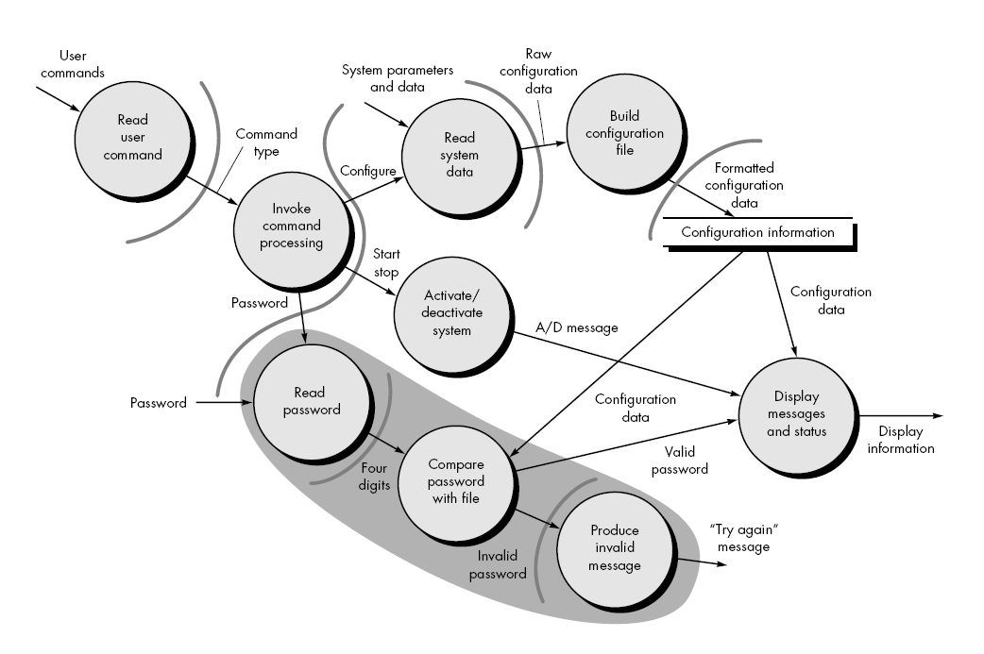
Level 2 DFD for user interaction subsystem with flow boundaries

Slide 20
Step 3: Determine whether DFD has transaction flow or transform flow characteristics
Steps 1, 2, and 3 are identical to corresponding steps in transform mapping.
The DFD has a classic transaction flow characteristic. However, flow along two of the action paths emanating from the invoke command processing bubble appears to have transform flow characteristics. Therefore, flow boundaries must be established for both flow types.

Slide 21
Step 4: Identify Transaction Center and flow characteristics along each of action paths
The location of the transaction center can be immediately discerned from the DFD. The transaction center lies at the origin of a number of actions paths that flow radially from it. Invoke command processing bubble is the transaction center.
The incoming path and all action paths must also be isolated.
Each action path must be evaluated for its individual flow characteristic. For example, the "password" path (shown enclosed by a shaded area) has transform characteristics. Incoming, transform, and outgoing flow are indicated with boundaries.

Slide 22
Step 5: Map the DFD in a program structure amenable to transaction processing
Transaction flow is mapped into an architecture that contains an incoming branch and a dispatch branch.
The structure of the incoming branch is developed in much the same way as transform mapping.
Starting at the transaction center, bubbles along the incoming path are mapped into modules.
The structure of the dispatch branch contains a dispatcher module that controls all subordinate action modules.

Slide 23
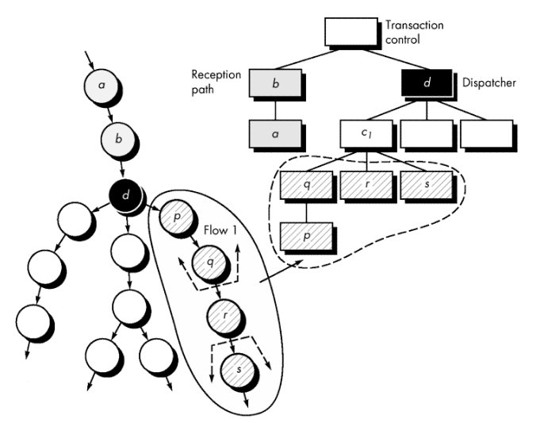
Transaction Mapping

Slide 24
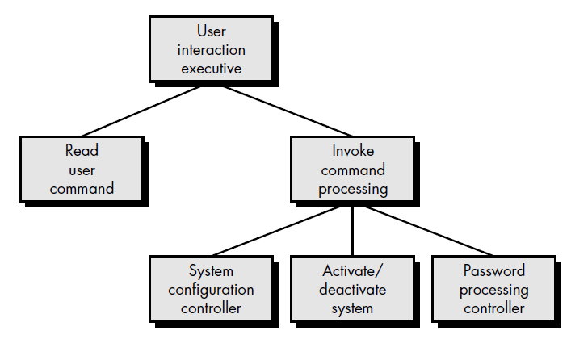
First-level factoring for user interaction subsystem
Notes:
The bubbles read user command and activate/deactivate system map directly into the architecture without the need for intermediate control modules. The transaction center, invoke command processing, maps directly into a dispatcher module of the same name.

Slide 25
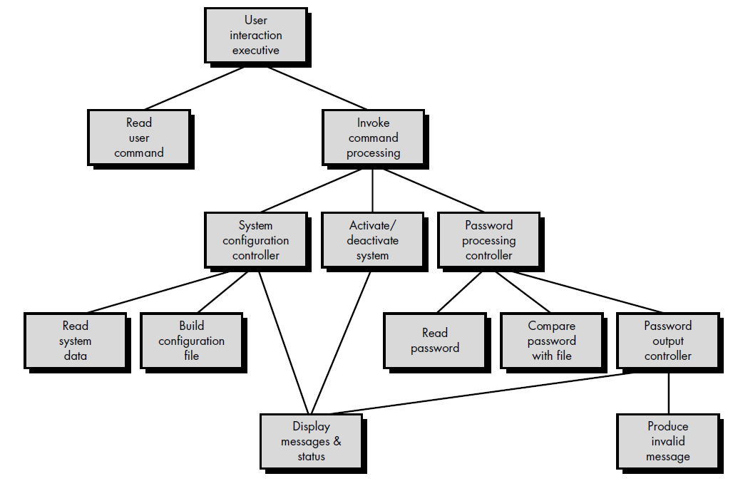
Step 6: Factor and refine the transaction structure and the structure of each action path

Slide 26
Step 7: Refine the first architecture using design heuristics for improved software quality
This step for transaction mapping is identical to the corresponding step for transform mapping.
Criteria such as module independence, practicality (efficacy of implementation and test), and maintainability must be carefully considered.

